Slide 1
Business models behind Iaas, Saas, PaaS

Slide 2
IAAS, PAAS, SAAS
Infrastructure-as-a-Service is the essential-base level of cloud solutions. It includes everything — hardware infrastructure, networks, communication lines, storage, and all necessary software. The best-known providers of IaaS are Google, Amazon EC2, IBM, Rackspace Cloud Servers, Verizon, and SIM-Networks.
Platform-as-a-Service is a cloud services model within which a provider delivers to customers a platform for deployment of all apps that the customer needs in. Examples of PaaS solutions are Google App Engine, VMWare Cloud Foundry, IBM Bluemix, etc.
Software-as-a-Service is a cloud service model within which a customer uses various software products and apps deployed at the provider’s platform. Examples of SaaS solutions are Gmail, Livejournal, Jira, Confluence, Bitrix, WordPress, Citrix, etc.

Slide 3
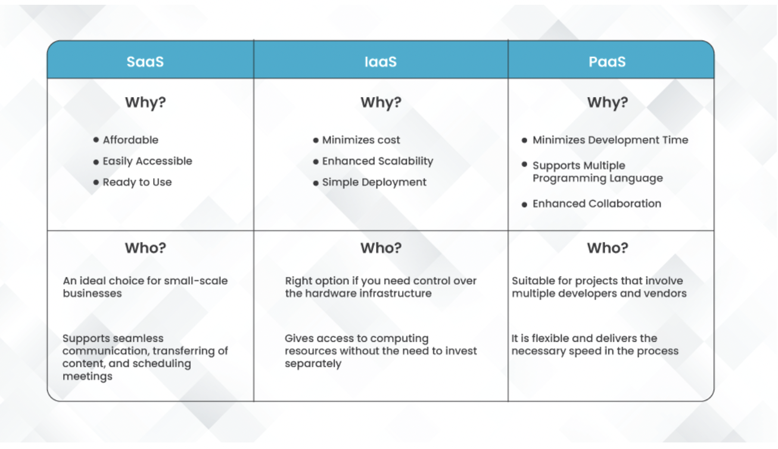
Difference between IAAS, PAAS, SAAS

Slide 4
Linux Commands Introduction
1. pwd — To know which directory you are in, you can use the “pwd” command.
2. ls — Use the "ls" command to know what files are in the directory you are in. You can see all the hidden files by using the command “ls -a”.
3. cd — Use the "cd" command to go to a directory.
4. mkdir— Use the mkdir command when you need to create a folder or a directory.
5. rmdir — Used to delete an empty directory.
6. rm - Use the rm command to delete files and directories. Use "rm -r" to delete just the directory.
7. touch — The touch command is used to create a file. It can be anything, from an empty txt file to an empty zip file. For example, “touch new.txt”.
8. man— To know more about a command and how to use it, use the man command. It shows the manual pages of the command.

Slide 5
9. --help —Typing in the command name and the argument helps it show which ways the command can be used
10. cp — Use the cp command to copy files through the command line.
11. mv — Use the mv command to move files through the command line. We can also use the mv command to rename a file.
12. locate — The locate command is used to locate a file in a Linux system, just like the search command in Windows.

Slide 6
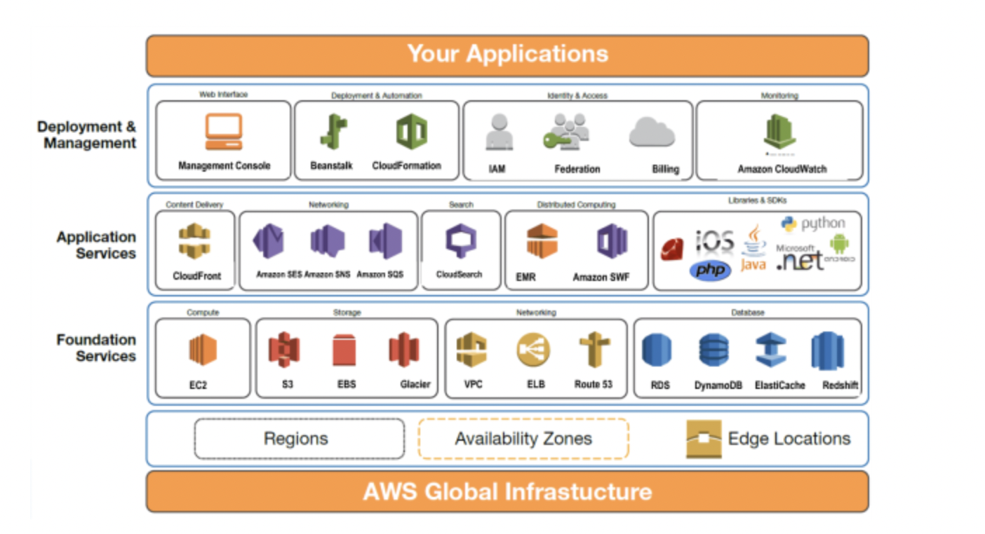
Infrastructure Overview

Slide 7
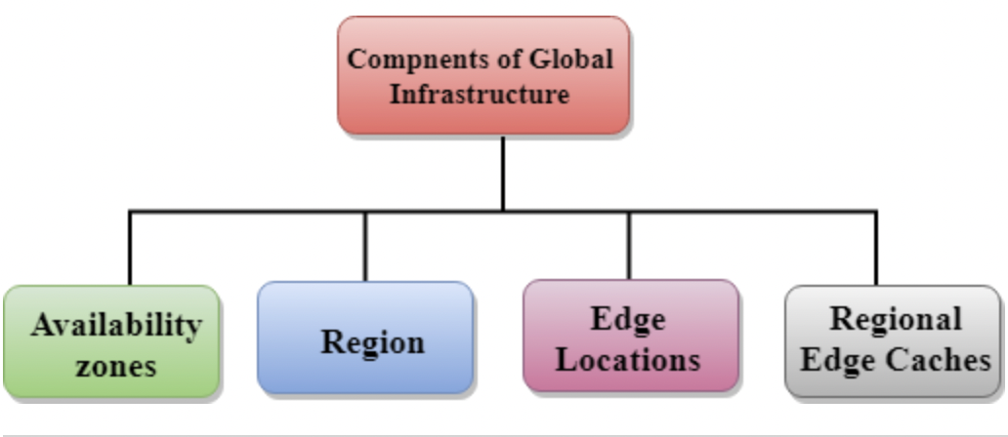
AWS is a cloud computing platform which is globally available.
Global infrastructure is a region around the world in which AWS is based. Global infrastructure is a bunch of high-level IT services which is shown below:
AWS is available in 19 regions, and 57 availability zones in December 2018 and 5 more regions 15 more availability zones for 2019.

Slide 8
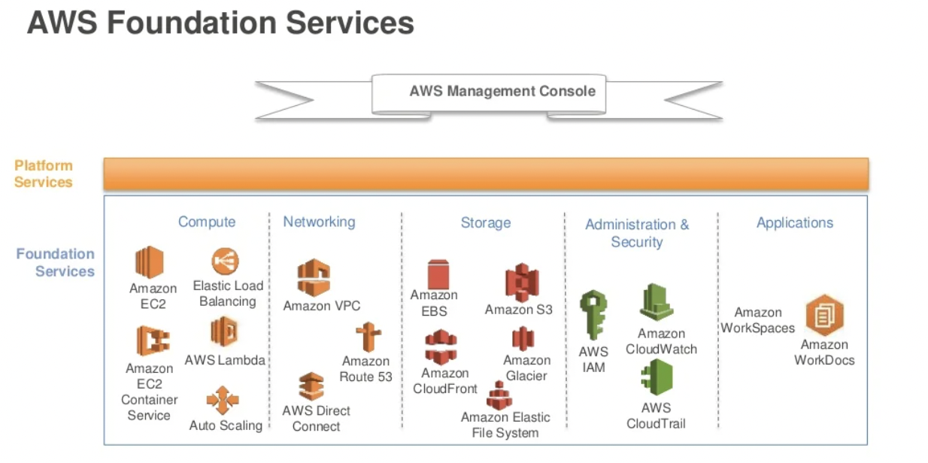
Introduction to AWS foundation services

Slide 9
Compute services are also known as Infrastructure-as-a-Service (IaaS). Compute platforms, such as AWS Compute, supply a virtual server instance and storage and APIs that let users migrate workloads to a virtual machine.
Networking services offer a wide range of databases and networking options which are scalable, on-demand, and available with a few clicks of the mouse.
Cloud storage is a cloud computing model that stores data on the Internet through a cloud computing provider who manages and operates data storage as a service.
With AWS, you control where your data is stored, who can access it, and what resources your organization is consuming at any given moment.
Amazon Workspaces enables you to provision virtual, cloud-based Microsoft Windows or Amazon Linux desktops for your users, known as Workspace. Workspaces eliminates the need to procure and deploy hardware or install complex software. You can quickly add or remove users as your needs change.

Slide 10
Introduction to developer tools
The AWS Developer Tools is a set of services designed to enable developers and IT operations professionals practicing DevOps to rapidly and safely deliver software. Together, these services help you securely store and version control your application's source code and automatically build, test, and deploy your application to AWS or your on-premises environment.
You can use AWS CodePipeline to orchestrate an end-to-end software release workflow using these services and third-party tools or integrate each service independently with your existing tools.

Slide 11
Introduction to management tools
AWS Management Tools helps the user to manage the components of the cloud and their account. It programmatically allows the user to provision, monitor, and automate all the components.
There are 4 types of Management Tools which are integrated with the AWS platform, this integration is from Amazon EC2 to Dynamo DB. This AWS Management tools help the user to control every part of the cloud infrastructure.

Slide 12
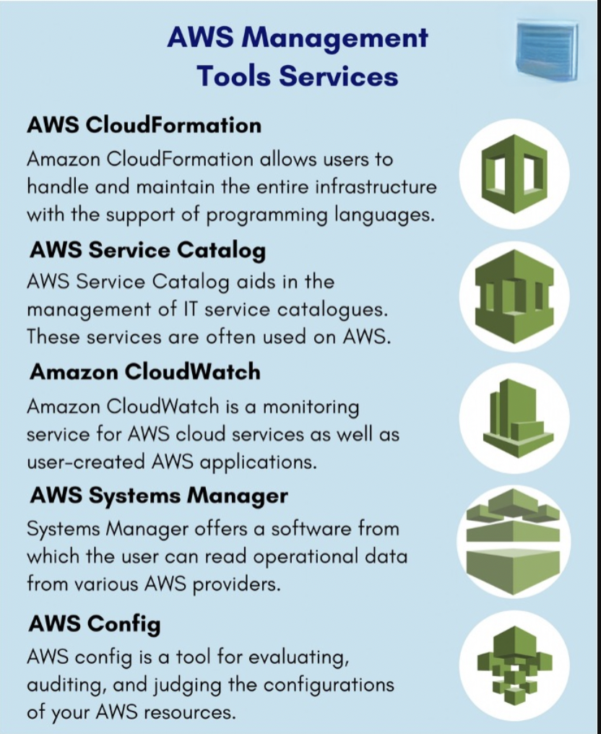
These are the category of Management tools in Amazon Web Services:

Slide 13
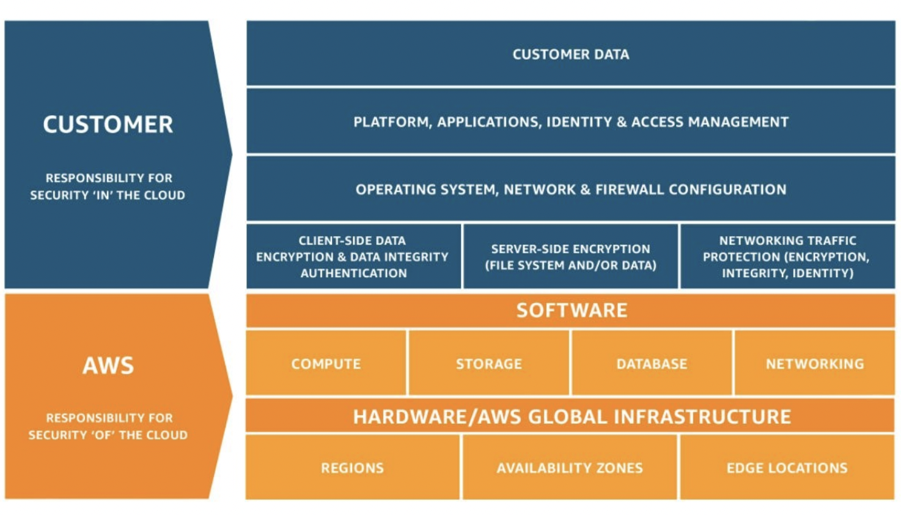
Shared Responsibility model

Slide 14
The shared model provides constructive mechanisms to illustrate the separation of tasks between AWS and the customer. AWS is responsible for the security and compliance of the Cloud, whereas the customer is responsible for security and compliance in the Cloud.
AWS is responsible for protecting the infrastructure that runs all of the services offered in the AWS Cloud. This infrastructure is composed of the hardware, software, networking, and facilities that run AWS Cloud services.

Slide 15
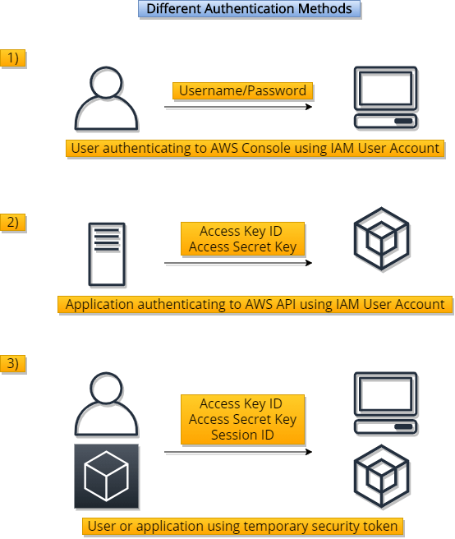
Iam authentication and authorization

Slide 16
AWS Identity and Access Management (IAM) allows customers to authenticate to any AWS service using the same credential format. IAM supports multiple means of authentication including API access keys, console-based user passwords, and federation using external identity providers.
The security mechanisms that define and manage identity and access management are among the most critical parts of an information security program. They serve to ensure that only authenticated principals (users, roles, groups, applications, and other identities) are authorized to access the targeted resource in the manner intended and with the least privilege.

